Slide 1
Socioeconomic Determinants of Electric Vehicle Adoption in Czechia
Jindra Lacko
KEKO VŠE

Slide 2
Introduction
Replacing ICE vehicles by EVs is a key part in most CO2 emissions reduction plans
Understanding, and proactively managing, EV adoption has policy implications
Spatial Econometrics is well positioned to provide such understanding

Slide 3

Data & Methods
Vehicle registration data (n = 1 451 075) from MDČR were evaluated at ORP level (n = 206)
Socioeconomic variables (n = 37) from 2010 census considered as possible predictors
Variable selection via stepwise regression technique, utilizing BIC selection criterion
Moran's I for measuring spatial (auto)corelation

Slide 4
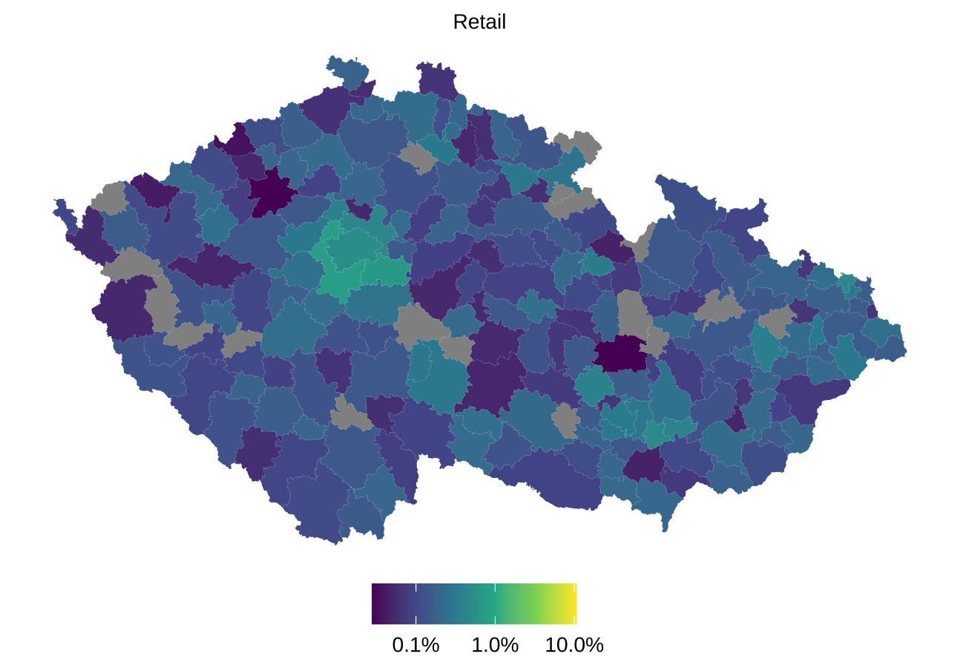
Results I
EV adoption is strongly concentrated, unlikely to be result of a random process
Prague and suburbs visually stand out (+ Brno & Ostrava)

Slide 5
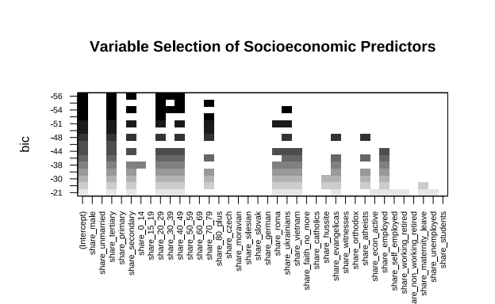
Results II
Stepwise regression technique via R package {leaps} identified 5 significant (out of 37) predictors (+ intercept)
Spatial distribution of residuals after regression can be considered random

Slide 6
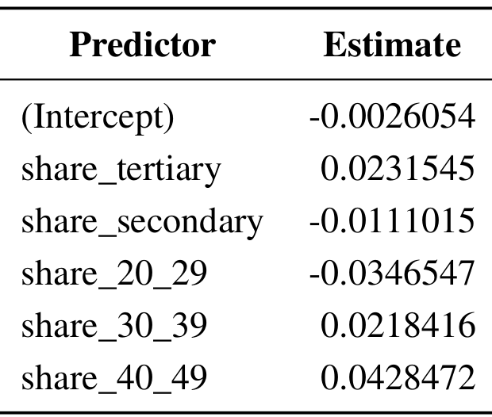
Results III
2 predictor variables relate to education
3 predictor variables relate to age
All 5 are known to be related to personal income (not included in census dataset directly)

Slide 7
Conclusion
Our model of 5 predictors is highly significant, with F statistic 21.39792 and R² 0.3485121
The model resolved the initially strong spatial autocorrelation (important OLS assumption)
Possible unifying theme of the 5 predictors is personal income as a driver of EV adoption
More research is needed, using more data

